Slide 2
INTRODUCTION
Retail Market Basket Analysis is a data mining technique used to analyze customer purchasing behavior.
It identifies products that are frequently bought together in retail transactions.
This helps businesses understand hidden patterns in customer buying habits.
The project uses the Apriori algorithm to extract meaningful associations from transaction data.
These insights are useful for improving sales, marketing strategies, and store layout decisions.

Slide 3
Problem Statement
Retail stores generate large volumes of transaction data daily.
However, this data is not properly analyzed to extract useful insights.
Businesses are unable to identify relationships between products.
This leads to missed opportunities in cross-selling and product bundling.
There is a need for automated techniques to analyze large datasets and discover hidden patterns.

Slide 4
Objectives
.To analyze customer purchase behavior using transaction data.
To identify frequently purchased items using Apriori algorithm.
To generate association rules based on support, confidence, and lift.
To discover hidden relationships between grocery products.
To improve business decision-making using data-driven insights.
To support marketing and retail strategy optimization.

Slide 5
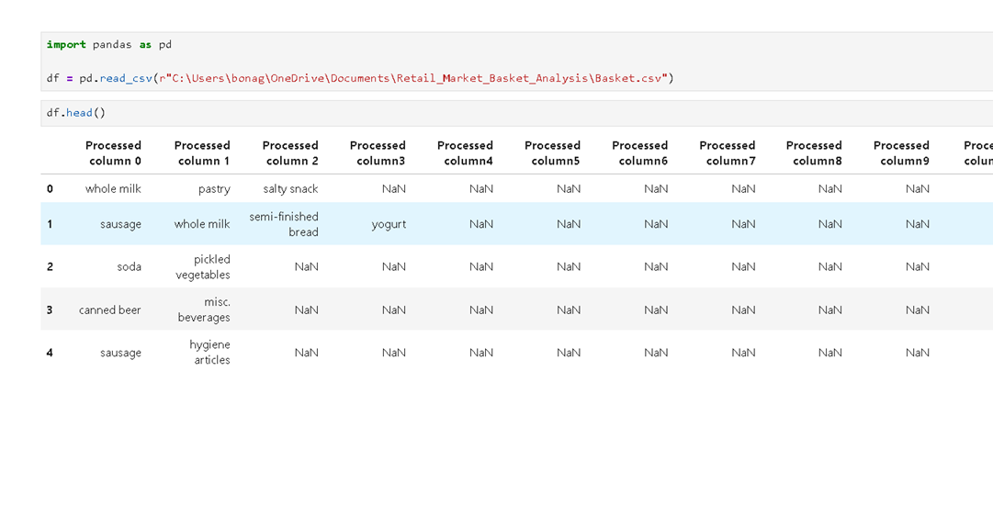
Dataset Description
The dataset contains 14,963 retail transactions.
It includes 167 unique grocery products.
Each row represents items purchased in a single transaction.
Products include dairy, vegetables, beverages, bakery items, and household goods.
The dataset is suitable for Market Basket Analysis and association rule mining.

Slide 6
Tools & Technologies
Python: Used for data analysis and algorithm implementation.
Jupyter Notebook: Used for coding and visualization.
Pandas: Used for data manipulation and preprocessing.
NumPy: Used for numerical operations.
Mlxtend: Used for Apriori algorithm and rule mining.
Matplotlib & Seaborn: Used for visualization.
Power BI: Used for dashboard creation and reporting.

Slide 7
Methodology
Step 1: Collection of retail transaction dataset
Step 2: Data cleaning and preprocessing
Step 3: Conversion of dataset into transaction format
Step 4: Encoding using TransactionEncoder
Step 5: Applying Apriori algorithm
Step 6: Generating association rules
Step 7: Visualization of results
Step 8: Interpretation of business insights

Slide 8
Data Processing
Missing values were identified and removed.
Data was transformed into transaction lists.
Each transaction contains multiple purchased items.
One-hot encoding was applied using TransactionEncoder.
Final output is a binary matrix (True/False format).
Dataset is now ready for pattern mining.

Slide 9
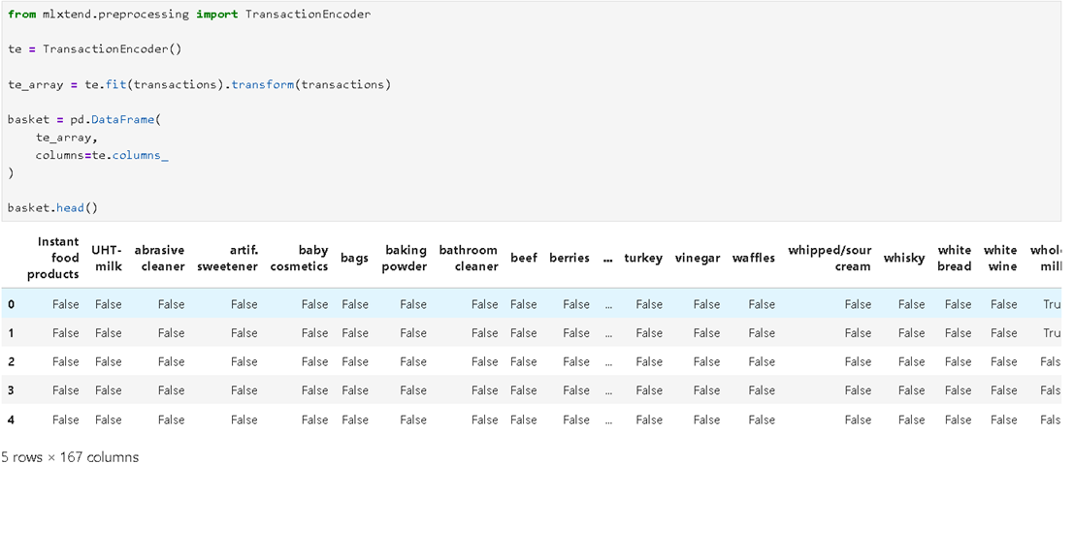

Slide 10
Apriori Algorithm
Apriori algorithm is used for frequent itemset mining.
It works on the principle of “frequent itemsets generate frequent subsets.”
It uses minimum support threshold to filter itemsets.
Generates candidate itemsets iteratively.
Removes infrequent itemsets using pruning technique.
Produces strong association rules using confidence and lift.

Slide 11
Results
Total transactions analyzed: 14,963
Total products: 167
Frequent itemsets generated: 126
Association rules generated: 19
Strong relationships identified between grocery items
Useful patterns discovered for business analysis

Slide 12
Visualizations
Top 10 most purchased products shown using bar chart
Frequent itemsets analyzed using support values
Confidence vs Lift scatter plot shows rule strength
Support vs Confidence shows relationship distribution
Visualizations help interpret customer behavior easily

Slide 13
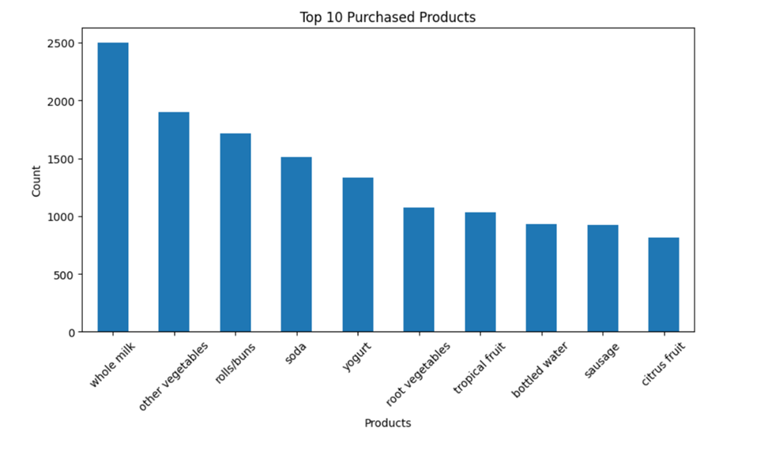
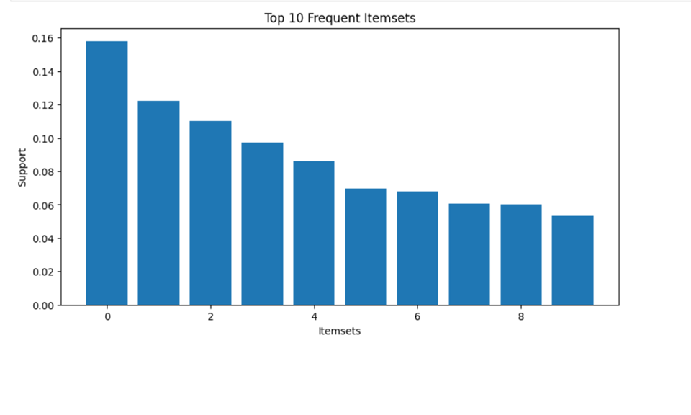

Slide 14
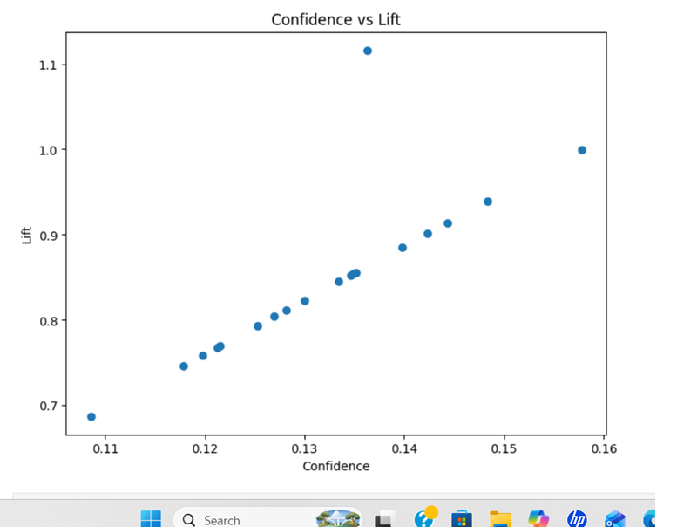
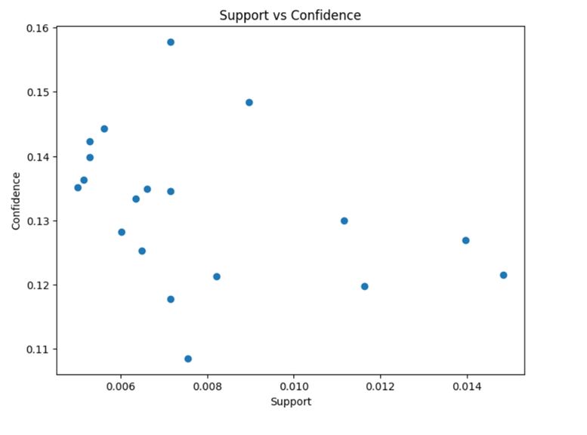

Slide 15
Key Findings
Whole milk is the most dominant product in transactions
Many products are frequently purchased together
Strong associations exist between dairy and grocery items
Frankfurter and vegetables show strong correlation
Customer buying behavior is pattern-driven

Slide 16
Business Applications
Helps in product placement optimization in stores
Improves cross-selling and upselling strategies
Supports product bundling and promotions
Enhances inventory management efficiency
Enables recommendation systems in retail

Slide 17
Conclusion
The Apriori algorithm successfully identified hidden patterns in data.
Frequent itemsets and association rules were generated.
The analysis provides meaningful business insights.
Helps retailers improve sales and customer satisfaction.
Data-driven decision-making is enhanced using this approach.

Slide 18
Future Scope
Use larger datasets for better accuracy and insights
Implement FP-Growth for faster processing
Build AI-based recommendation systems
Integrate real-time retail analytics
Develop advanced dashboards using Power BI or Tableau

Slide 19
THANK YOU

